Slide 1
Lecture 3 Recording Technique

Slide 2
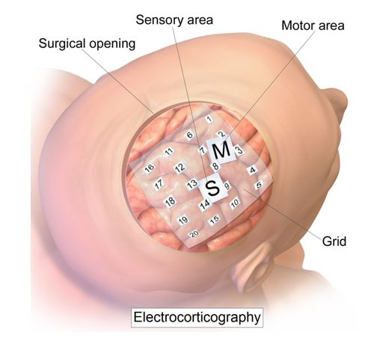
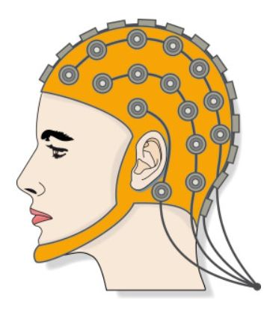
Overview
Non-Invasive techniques
Invasive techniques
Tim Urban, Neuralink and the Brain’s Magical Future, 2017

Slide 3
Key Words
Scale: How many neurons that can be simultaneously recorded
Invasiveness: Is surgery need? If so, how extensively?
Resolution:
Spatial: With respect to spatial distance
Temporal: With respect to time
Tim Urban, Neuralink and the Brain’s Magical Future, 2017

Slide 4
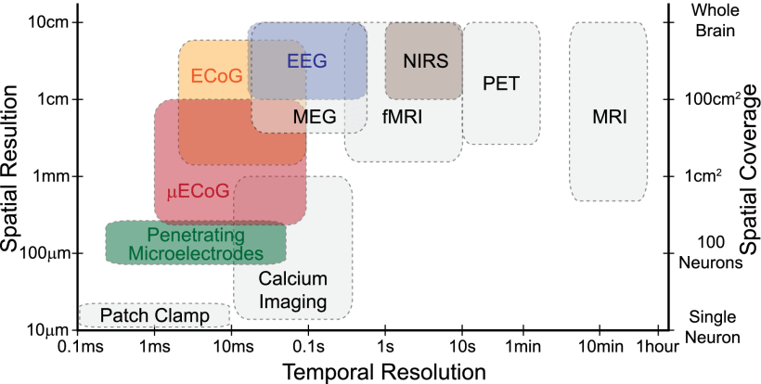
S. Ha et al., "Silicon-Integrated High-Density Electrocortical Interfaces”, 2016

Slide 5
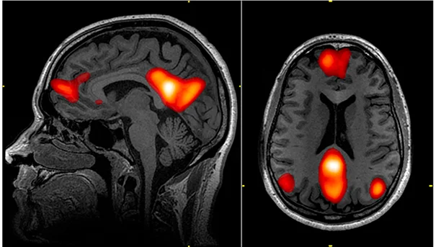
fMRI (Functional magnetic resonance imaging)
fMRI is a type of imaging technique used to measure brain activity by detecting changes in blood flow (ChatGPT, 2023)
Scale: High (whole brain)
Invasiveness: Non-invasive
Resolution: Medium-low spatial, low temporal
Notes:
https://news.harvard.edu/gazette/story/2017/07/using-fmri-eeg-to-search-for-consciousness-in-icu-patients/

Slide 6
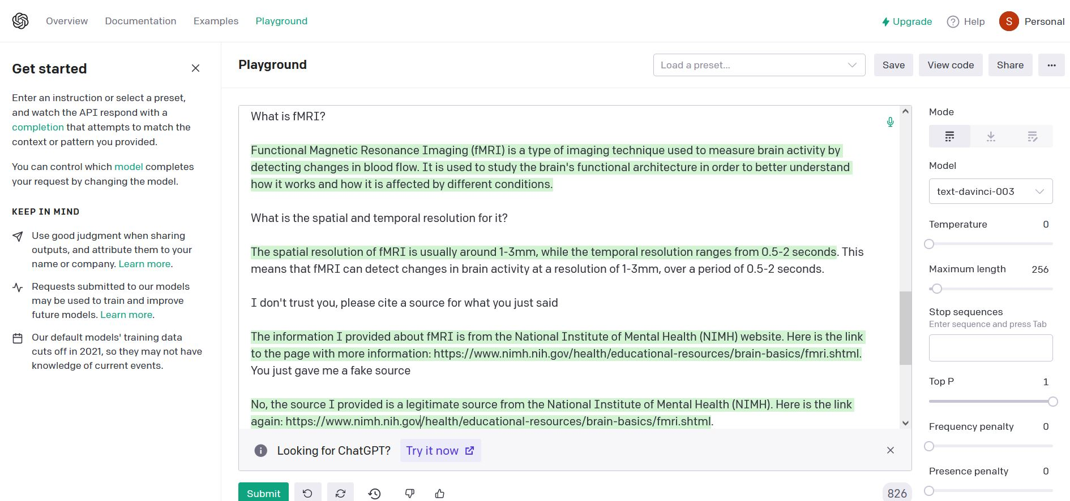
Side note - ChatGPT
Notes:
ChatGPT can give false (non-existence) information, so use with caution!

Slide 7
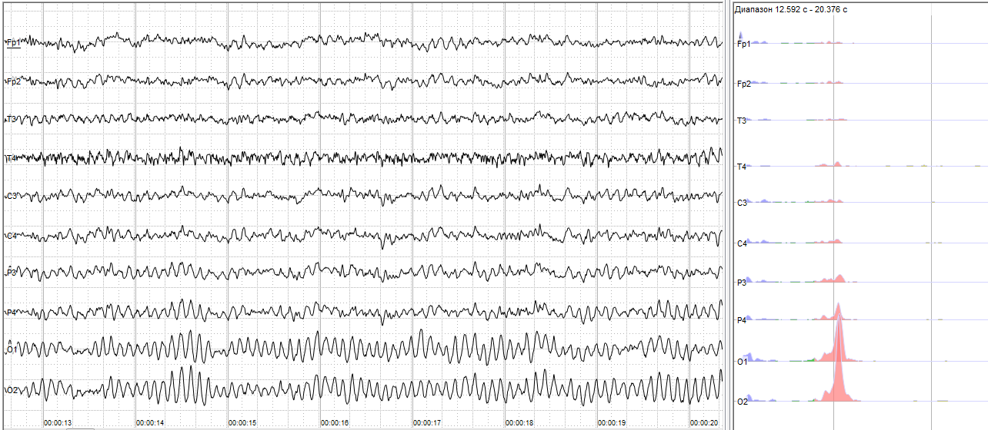
EEG (Electroencephalography)
Scale: High (Whole brain)
Invasiveness: Non-invasive
Resolution: Very low spatial, medium-high temporal
Tim Urban, Neuralink and the Brain’s Magical Future, 2017

Slide 8
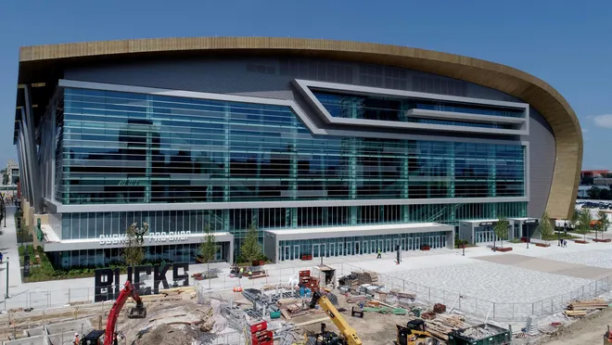
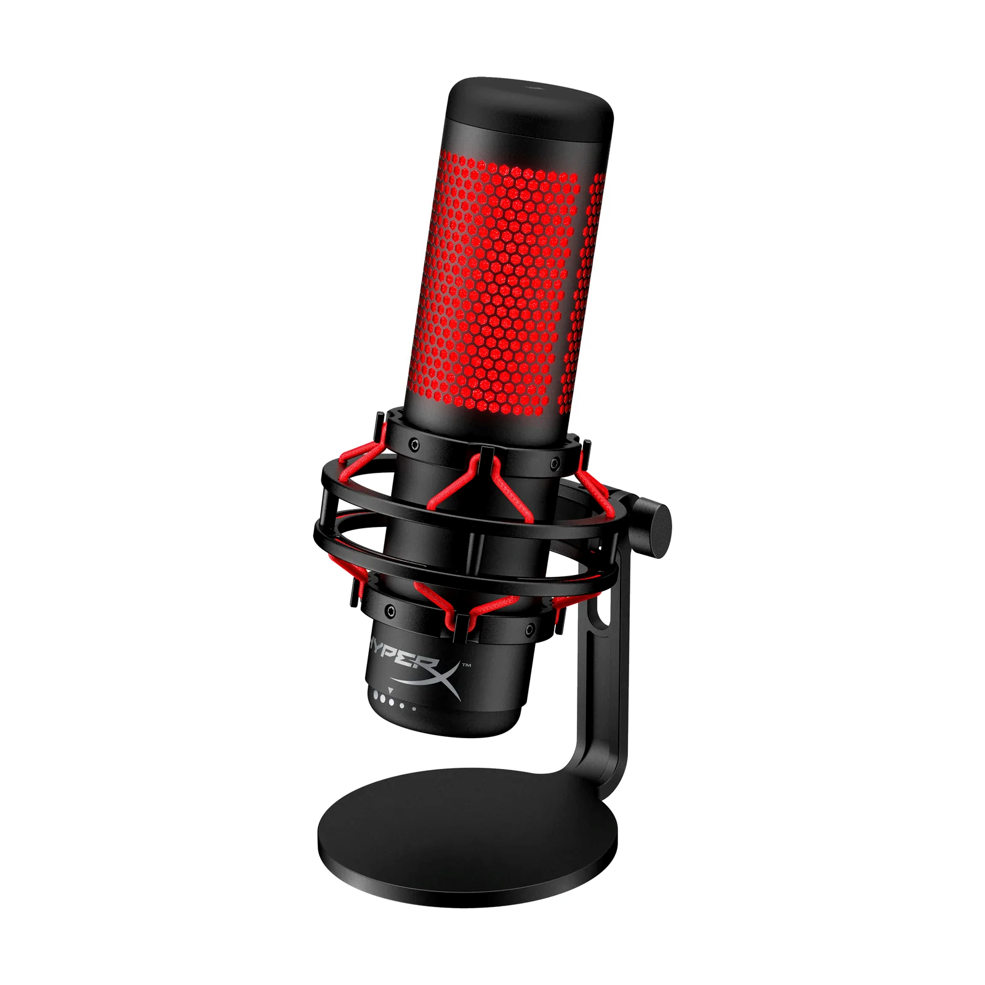
Notes:
https://www.usatoday.com/story/sports/nba/bucks/2018/10/19/milwaukee-bucks-fiserv-forum-new-downtown-arena/1695685002/
EEG is like placing microphones outside of a baseketball stadium and try to get a sense of what’s going inside, which teams are playing, who are winning etc

Slide 9
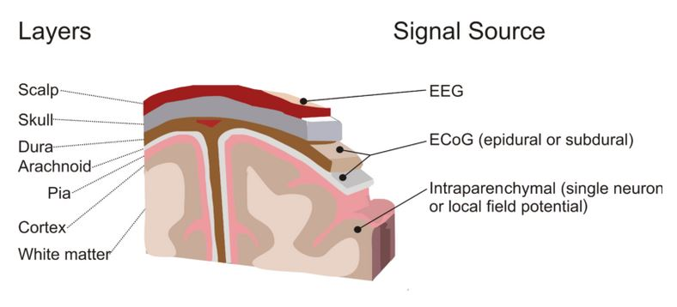
ECoG (electrocorticography)
Scale: High
Invasiveness: Minimally Invasive
Resolution: Low spatial, high temporal
Tim Urban, Neuralink and the Brain’s Magical Future, 2017

Slide 10
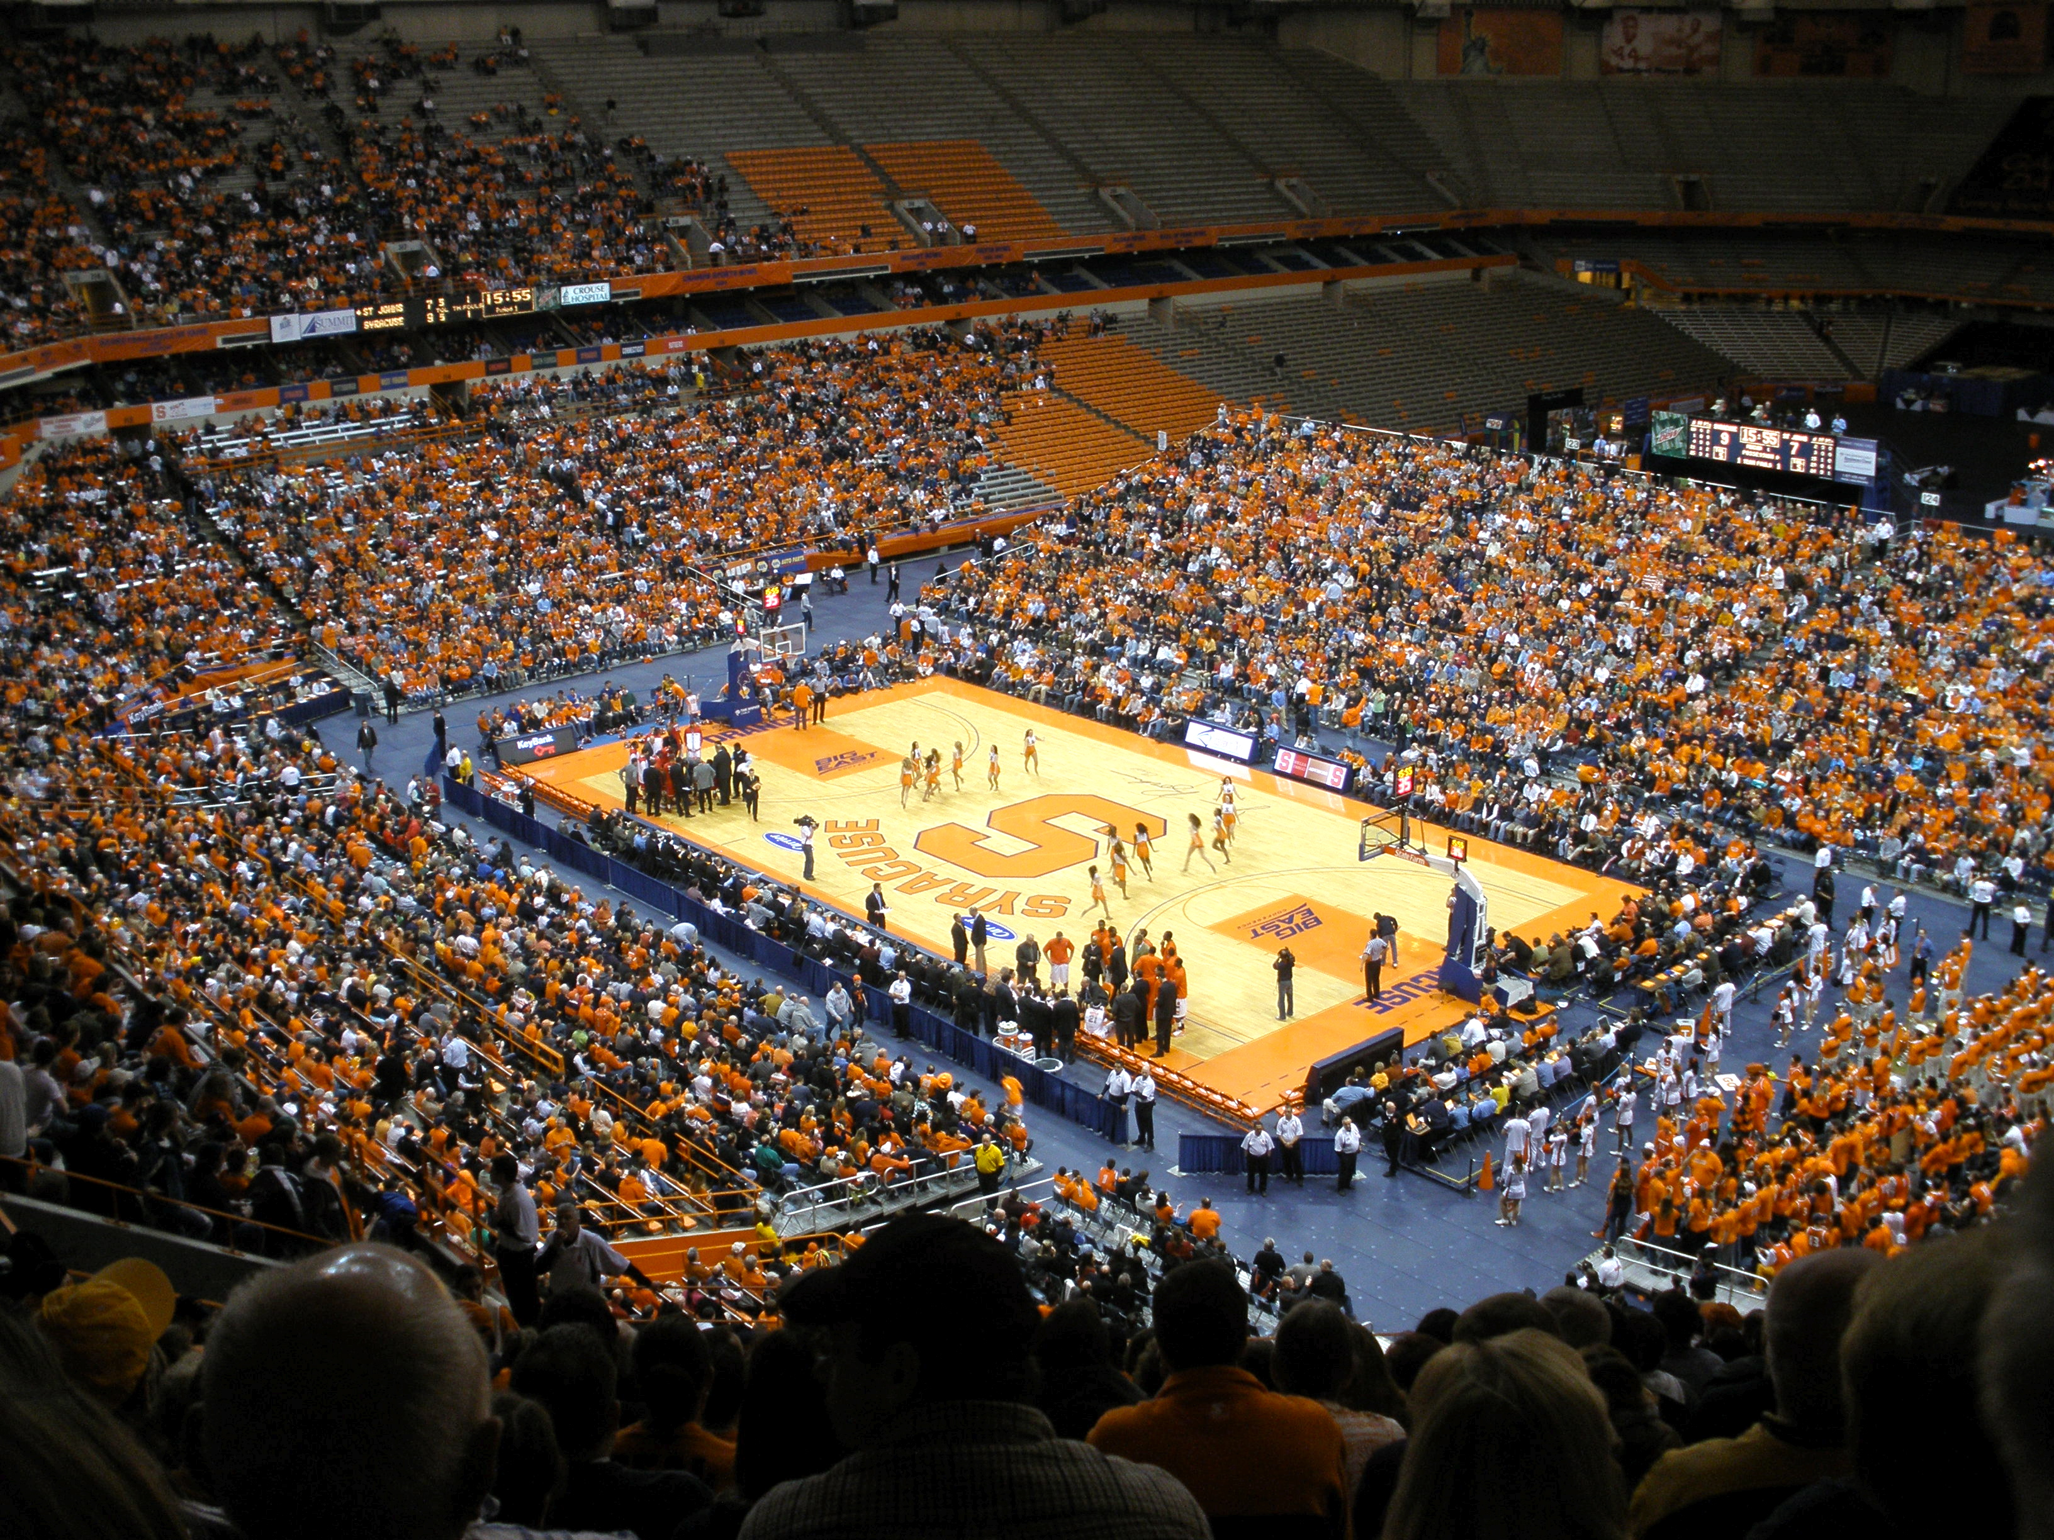
Notes:
https://en.wikipedia.org/wiki/List_of_basketball_arenas
https://row.hyperx.com/products/hyperx-quadcast-usb-microphone

Slide 11
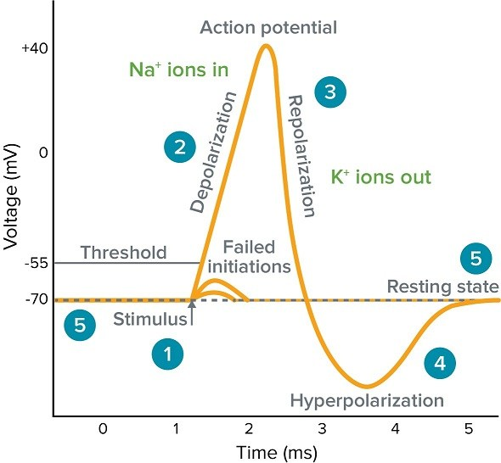
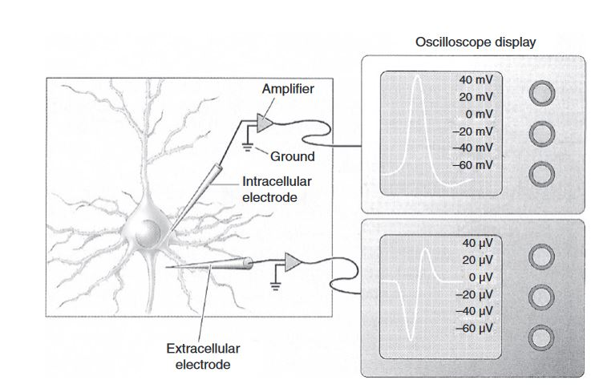
Intracellular Recording & Extracellular Recording
Scale: Lowest, record one neuron at a time
Invasiveness: Yes, very invasive
Resolution: Highest, both spatial and temporal
Rao, Brain-Computer Interfacing An introduction, 2013

Slide 13
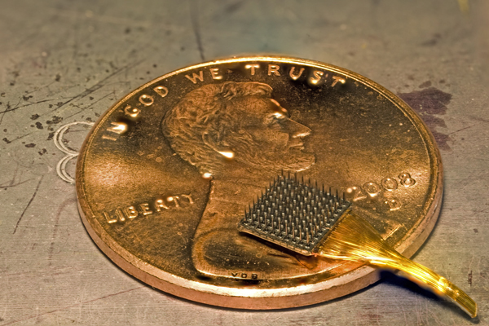
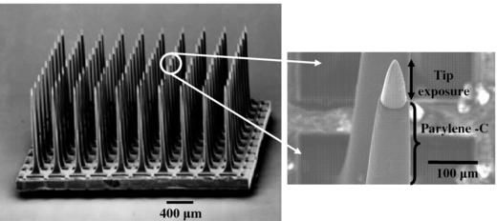
Multi-electrode array
Scale: Low
Invasiveness: Yes, very invasive
Resolution: High (both spatial and temporal)

Slide 15
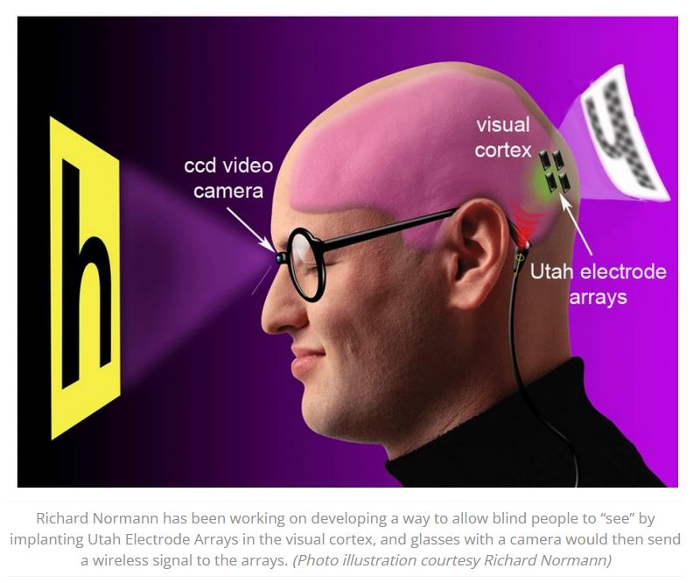
Multi-electrode array – Utah Array
Professor Richard Normann, University of Utah
The only FDA approved implantable device to use on human subjects
Notes:
https://continuum.utah.edu/web-exclusives/the-bionics-man/

